Slide 1
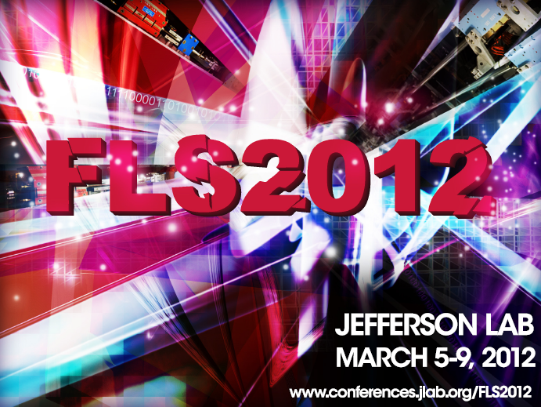
The FLS2012 FEL Working Group Summary
Kwang-Je Kim and Tor Raubenheimer
for the FEL Working Group
March 9th, 2012

Slide 2
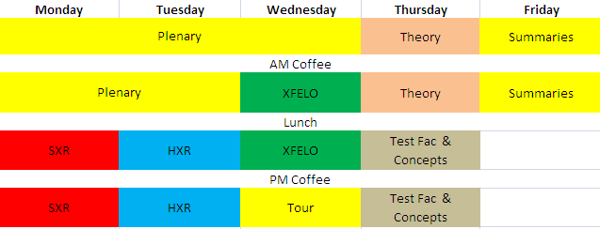
Schedule of Sessions
29 talks by 24 people, divided into 5 sessions:
  Soft X-ray FELs
  Hard X-ray FELs
  X-ray FEL Oscillators
  FEL Theory
  Test Facilities and Design Concepts

Slide 3
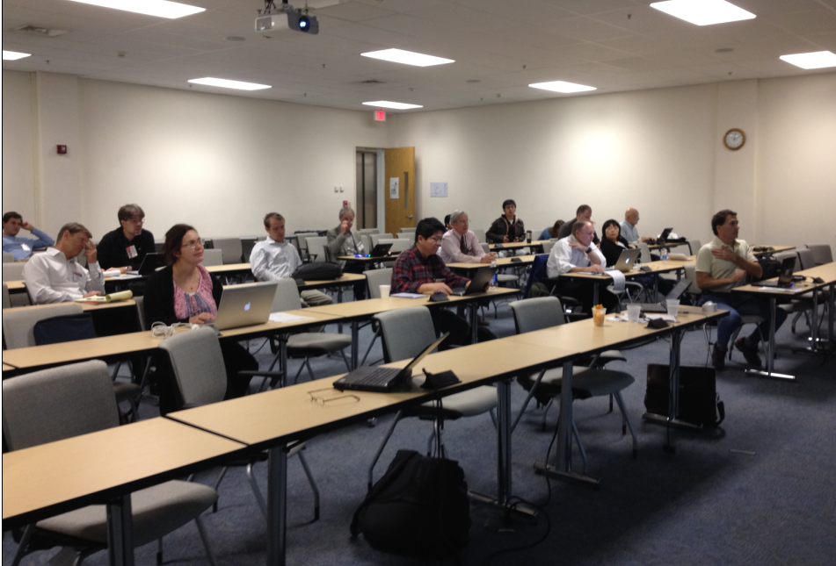
The Working Group
(Roughly 35 Participants)

Slide 4
Soft X-ray FELs
Discussion of SXR facilities, future facility plans and R&D needed to develop capabilities
(Approximate) Title | Speaker
Overview of SXR FELs | Richard Walker
The LUNEX5 Project | Marie-Emmanuelle Couprie
LBNL Studies for the NGLS | John Corlett
A Soft X-ray Self-Seeding Experiment | Phil Heimann
Plans for Echo-75 | Erik Hemsing

Slide 5
Users’ Requirements
R. Walker
high pulse energy
transverse coherence
fs pulses (or less)
polarization control
easy tunability
multiple, simultaneous users
high repetition rate
regularly spaced pulses
THz radiation in synchronism with FEL
two-colour FEL pulses
longitudinal coherence / pulse uniformity*
high degree of amplitude stability*
small linewidth*
precise synchronism with lasers for pump-probe expts.
Most requirements not specific to soft X-rays …
Especially for soft-X-ray FELs (?) .. that was the view, but now XFEL users are starting to demand such properties

Slide 6
SXR Facilities, Projects and Tests
John Corlett & M-E Couprie
Common themes:
  High Rep rate
  Longitudinal coherence
  Low cost
NGLS – 1 MHz, 280 eV – 1.2 keV
  Based on 2 GeV, CW SCRF → undulator farm
  R&D on electron source, beam separator, undulators, polarization control, and seeding approaches (Self-seeding, EEHG, HHG+HGHG)
LUNE5X – 0.4 GeV SCRF & 1 GeV LWFA
  New facility to study SXR generation and LWFA source
  Study seeding approaches and undulator technologies

Slide 7
SXR Seeding Concepts
Phil Heimann & Erik Hemsing
SXR Self-Seeding experiment
  Design for an experiment on LCLS being developed for ~2014
SXR Seeding Workshop @ LBNL → two paths
  Conventional laser @ 100 ~ 200 nm & EEHG @ 100th harmonic
    7th harmonic demonstrated at NLCTA and SSRF and plans for 75th
  HHG @ 10 ~ 40 nm & HGHG @ 10th or EEHG @ 50th harmonic
    R&D on HHG and laser spectral phase measurement and control
e-beam
ξ/2
M₁
M₃
2nd undulator
1st undulator
η/2
Source
plane
γ’/2
M₂
Re-entrant
plane
S
G

Slide 8
Hard X-ray Sessions
Hard X-ray (Tuesday PM)
  Overview (Z. Huang)
  Simulations of the self-seeding experiment at LCLS (J. Wu)
  Modeling and multi-dim. optimization of a tapered FEL(S. Spampinati)
  LCLS-2 Terawatt options (T. Raubenheimer)
  The proposed MaRIE X-ray FEL at Los Alamos (B. Carlsten)
  Compact hard x-rayFEL design based on an x-band RF linac ( Y. Sun)
  Tolerance for seeded FELs (J. Wu)

Slide 9
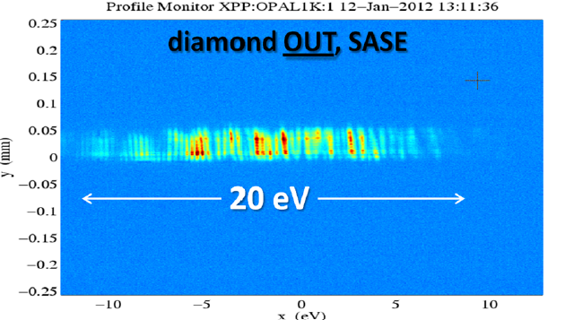
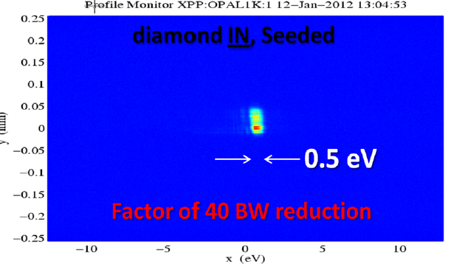
Hard X-ray FELs: Self-Seeding Works!
With further development, the full potential for self seed hard x-ray FEL will be reached
  Electron beam profile needs to be improved to remove double horn, chirp, etc.
Two bunch scheme may have additional advantages
  Difficult to bench mark with fluctuating initial SASE
Tapering is effective for seeded FEL→ realizing TW goal

Slide 10
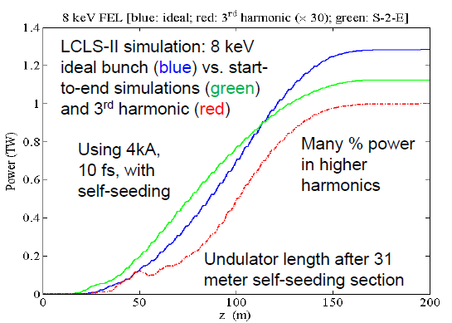
Hard X-ray FELs: Terawatts LCLS 2
Use seeding and heavily tapered undulator to increase power from 10’s GW → TW
  Extensive
  study over
  last year
  Focused on
  single bunch
  self-seeding
  option
  presently

Slide 11
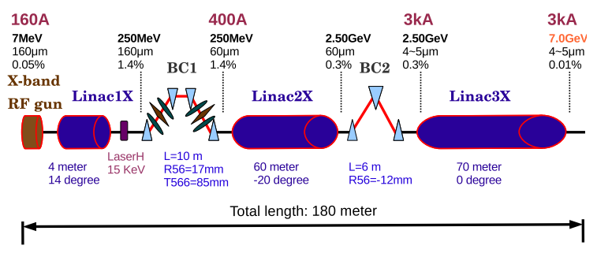
Further activities at LCLS
Attosecond regime with ultralow charge
Dechirping with wakefield
  Corrugated beam pipe
Enhanced SASE
Improvement of LCLS injector performance
  0.3 mm-mr , 150 pC bunches
Vigorous FEL physics study
  Tolerances for seeding scheme
  Understanding the tapering performance including 3D effects
  Compact XFEL with x-band RF

Slide 12
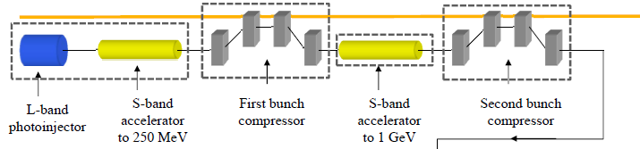
Hard x-ray FEL: MaRIE at LANL
Matter-Radiation Interactions in Extremes (MaRIE) ~ $2B for full capabilities ( Initially ~$1B)
12-GeV electron linac driving 42-keV (0.3Å) XFEL is cornerstone of MaRIE 1.0 (for 10¹⁰ SASE photons in 10⁻³ BW)
Advanced (and ambitious!) concepts for upgrade
  Non-Hamiltonian emittance partitioning
  Beam modulation employing EEX

Slide 13
X-Ray Oscillator Sessions
XFELO ( Wednesday PM I)
  Optics for VUV and soft x-ray FEL oscillators (M. Shinn)
  XFELO cavity design with asymmetric crystals (G.T. Park)
  The effect of mirror surface errors in XFELO cavity (G.T. Park)
ERL-FEL joint session on XFELO ( Wednesday PM II)
  Status of the ERL-based light source project in KEK and Cornell (S. Sakanaka)
  XFELO parameters (R. Lindberg)

Slide 14
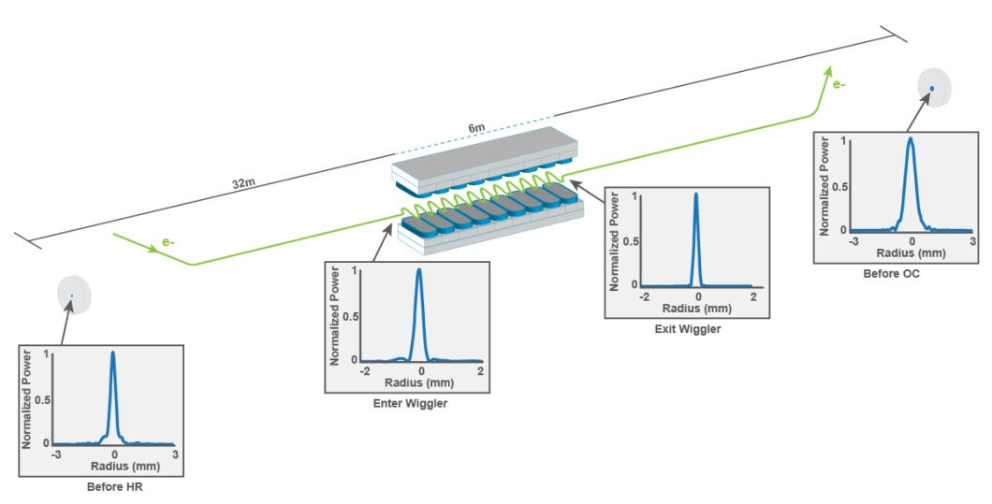
Soft X-ray FEL Oscillator
A novel “Flat HR” optical cavity configuration was developed at Jlab
  Unstable, low-Q cavity consisting of a flat high reflectivity mirror and a curved mirror with hole
  Moderately high-gain → optical guiding stabilizes the mode
  Mode does not avoid the hole, thus does not suffer from the well-known hole-coupling problem for a stable cavity
  Designed for VUV but could be a path toward 1 keV FEL oscillator

Slide 15
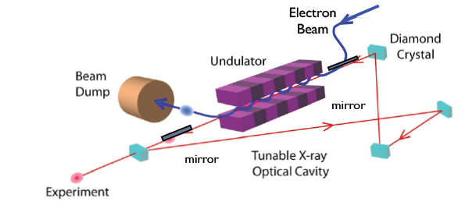
Hard X-Ray FEL Oscillator: Optics
Asymmetric crystals (surface not parallel to Bragg planes) for XFELO cavity
  Advantages: larger angular acceptance, larger x-ray footprint
  Issues: pulse length could keep increasing after each turn
  Cavity configurations were found in which the pulse dilation does not occur
Surface errors of curved focusing mirrors (required to adjust the transverse mode profile for optimum gain)
  Simulation based on Fourier optics
  Analytic study clarifying the role of figure errors and roughness errors

Slide 16
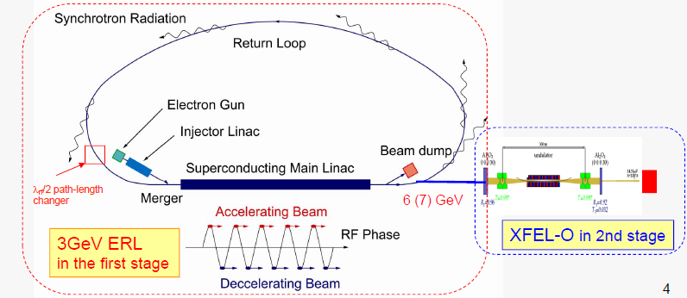
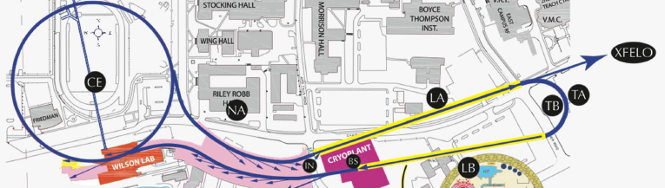
Hard X-ray FEL Oscillators will add to the capabilities of an ERL facility
6-7 GeV XFELO at KEK ERL in the second stage
Harmonic XFELO may be feasible for a 3 GeV ERL
7.8 GeV XFELO possible at Cornell ERL

Slide 17
XFELOs with ultra-low charge (1 pC) and ultra low emittance (0.062 mm-mr) may be attractive: lower intra-cavity power, higher rep rate, or shorter undulator with a factor of 10 smaller photons/pulse
 | “canonical” | Low Q 1 | Low Q 2
Electron E (GeV) | 7 | 7 | 7
Bunch Q (pC) | 25 | 1 | 1
Peak I (A) | 10 | 1.6 | 1.6
Norm em (μm) | 0.2 | 0.062 | 0.062
ΔE (MeV) | 1.4 | 0.25 | 0.25
Lund (m) | 52 | 52 | 35
Gain | 0.36 | 0.74 | 0.39
Rtot | 0.85 | 0.85 | 0.85
Photons/pulse | 1.110⁹ | 1.010⁸ | 1.210⁸
Δω (meV) | 2.0 | 6.3 | 5.6

Slide 18
FEL Theory Sessions
FEL-Sources joint session on Theory (Thursday AM I)
  Staged eigen emittance reduction techniques (K. Bishopberger)
  Dynamics of modulated beams (N. Yampolsky)
Theory (Thursday AM II)
  EEX-based beam compression with higher order corrections(K. Bishopberger)
  Enhanced harmonic up-conversion using hybrid HGHG-EEHG (Q. Marksteiner)
  Quantum noise in high-gain FELs (K.-J. Kim)

Slide 19
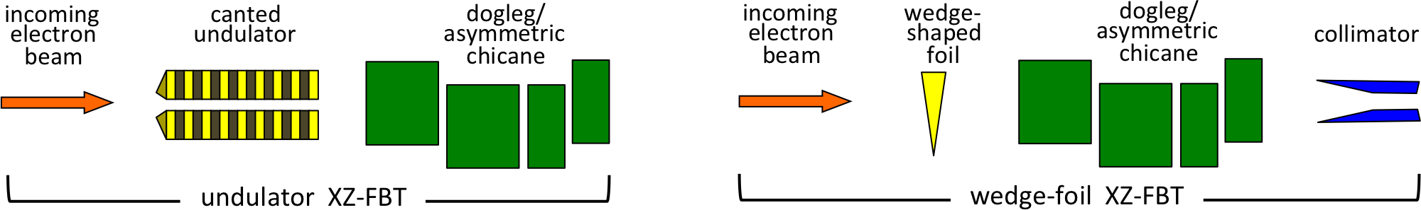
Eigen-Emittance Reduction
Extend ideas of Flat-Beam Transformer to longitudinal to further reduce emittances
  Initial thoughts to do this
  at cathode with a tilted
  laser
Concern that hard to preserve correllations from cathode
Considered two
alternate appraoches:
  Canted undulator
  at high energy
  Wedged foil
Thinking about tests
Normalized emittance | PITZ photoinjector | REDUCTION TECHNIQUES
0.1 μm | 25 pC | 250 pC
0.2 μm | 100 pC | 1 nC
Bishofberger

Slide 20
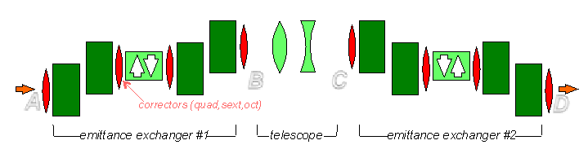
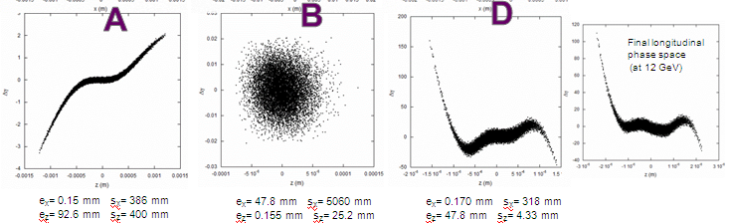
Emittance-Exchange Compression
Discussion of using EEX to reduce bunch length and possible shape longitudinal distribution
Believed to be less sensitive to CSR De
Possible to include high-order correction elements (sextupoles and octupoles) to compensate nonlinearities
Bishofberger
sigz = 400 um
sigz = 4 um

Slide 21
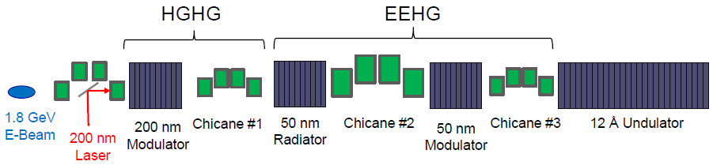
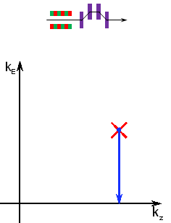
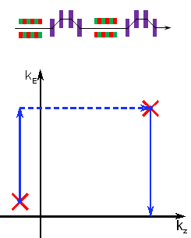
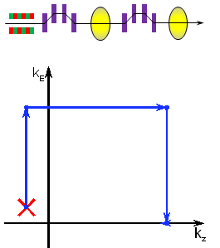
Seeding Approaches
Use of a combined (3-stage) harmonic generation to go
from 200 nm laser → 1 nm FEL
Marksteiner
Study different
bunching
approaches in
spectral domain
Understand
impact visually
Yampolsky

Slide 22
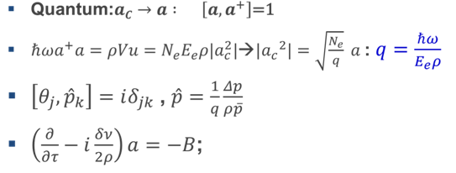
Quantum Noise
Kwang-Je calculated the additional noise in the FEL due to quantum effects
  Derived the FEL equation in terms of quantum operators
  Found result that it is a small effect but might be observable and possibly increased by mismatching the radiation ellipse to beam

Slide 23
Test facilities and Design Concepts
Test Facilities and Design Concepts (Thursday PM)
  RF power sources for XFELs and ERLs (A. Nassiri)
  Performance comparisons of S-, C-, and X-band based FEL facilities (Y. Kim)
  Modeling of the photon transport system of the ALICE FEL using wavefront propagation (M. Roper)
  FEL consideration for CLARA: A UK test facility for future light sources (D. Dunning)
  Preliminary study on two possible bunch compression schemes at NLCTA (Y. Sun)
  Enabled by Echo:EEHG and more at NLCTA (E. Hemsing)
  DWA for FEL facility (A. Zholents)

Slide 24
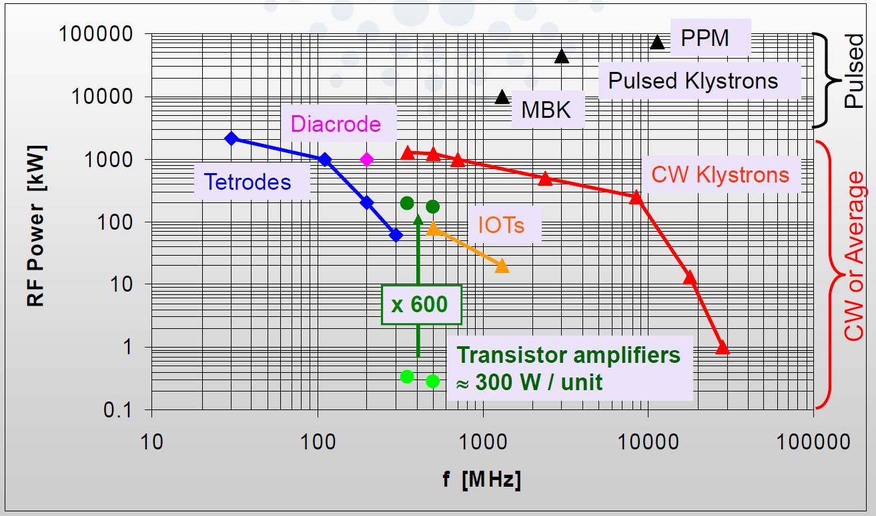
Rf Source Overview
× 1000
LDMOS Transistor ~1000W/unit
Nassiri
J. Jacob (ESRF)
A. Nassiri (ANL)
Solid-state sources can compete with tubes at the lower frequencies and power levels.
The outlook for higher-frequency, higher-power solid-state rf sources is promising but with many technical challenges.

Slide 25
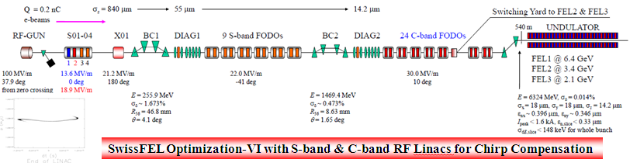
Rf Frequency Comparison
Y. Kim
Developed and optimized designs for S-band, C-band and X-band FEL’s
  Looked at overall size, beam parameters and tolerances
  Use SwissFEL as a basis for optimization
Noted advantages and disadvantages of different frequencies –
  Lots of detail (48 slides in 15 minutes) – see posted slides

Slide 26
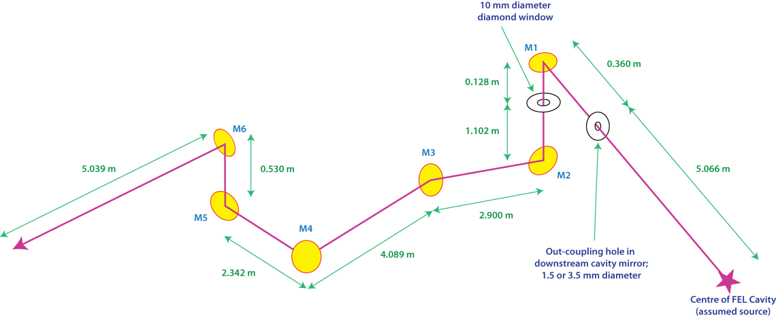
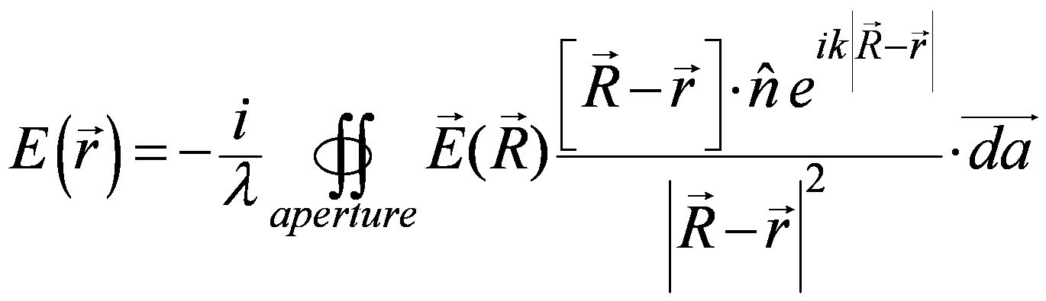
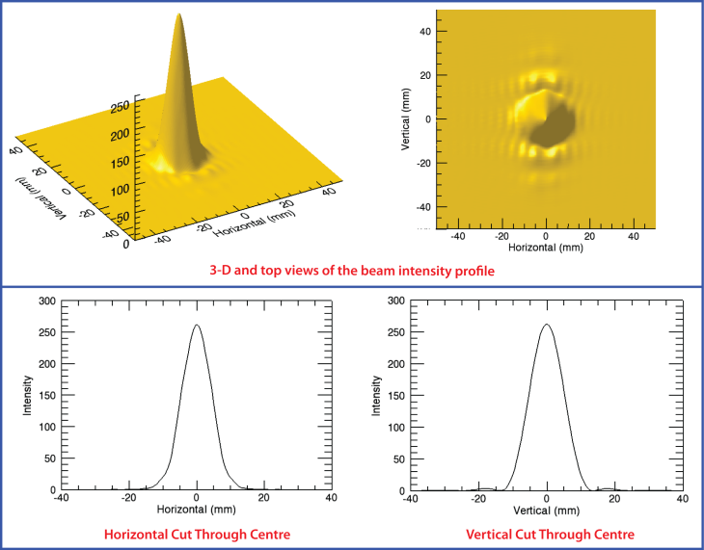
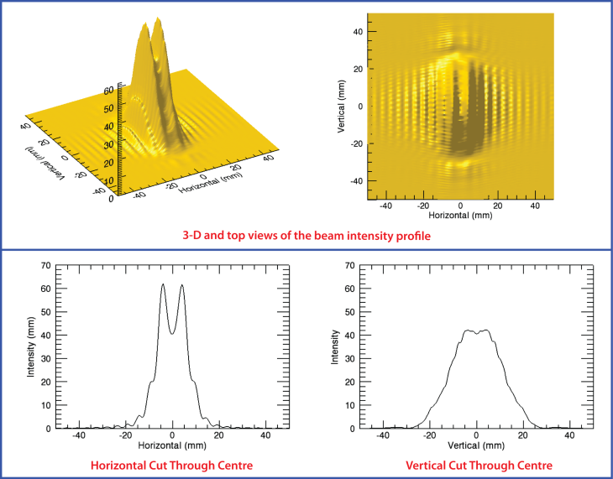
Photon Transport Calculations in ALICE
ALICE is an ERL/FEL test facility at Daresbury
  26 MeV beam with 1625 bunches in 100 us @ 10 Hz
Complicated photon transport modeled with FOCUS code
Wavefront propagation
Mark Roper
3 mm
aperture
1.5 mm
aperture

Slide 27
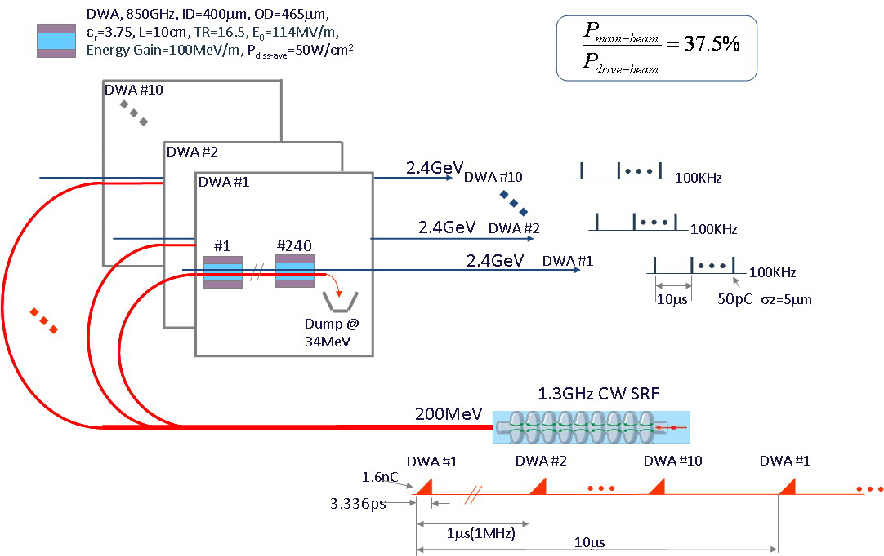
DWA and LWFA
Use SCRF to generate high power beam → use dielectric wakefield accelerator to accelerate to high energy
PWFA was discussed
in plenary and in
reference to LUNE5X
Zholents
FEL10
FEL2
FEL1
1 MHz,
P=320 kW
Both DWA and LWFA
tend to leave beams
with large chirps

Slide 28
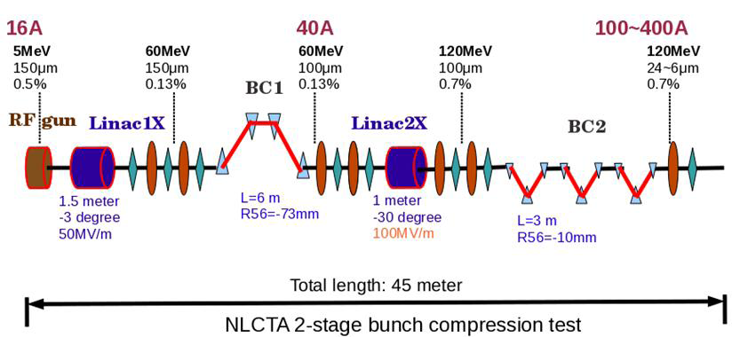
Test Facilities
Three facilities described in detail:
  LUNEX5 (Soleil – Monday pm)
  CLARA (Daresbury)
  NLCTA (SLAC)
Broad program including undulator technology, acceleration concepts, beam dynamics and seeding
Explicit talk describing test of advanced bunch compression concepts:
  two tests, one using existing hardware and one with small upgrade

Slide 29
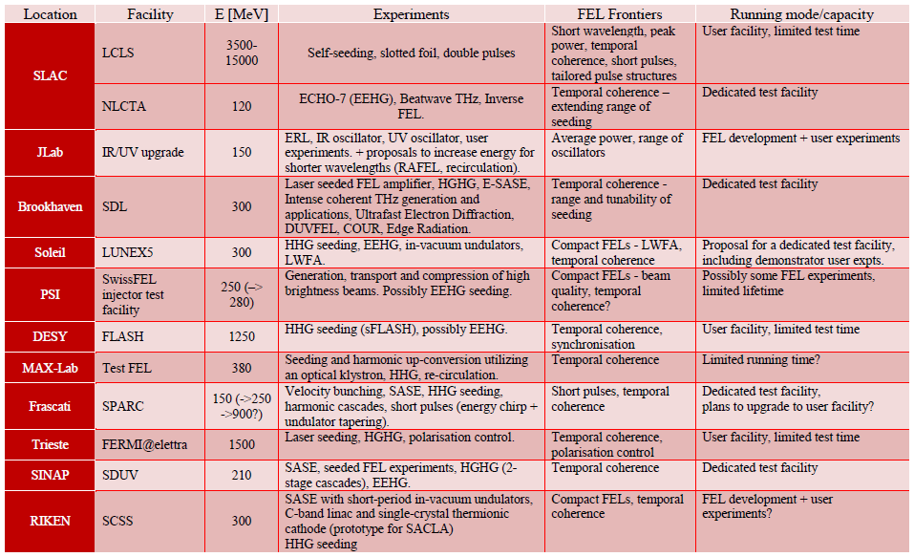
Survey of Facilities
David Dunning

Slide 30
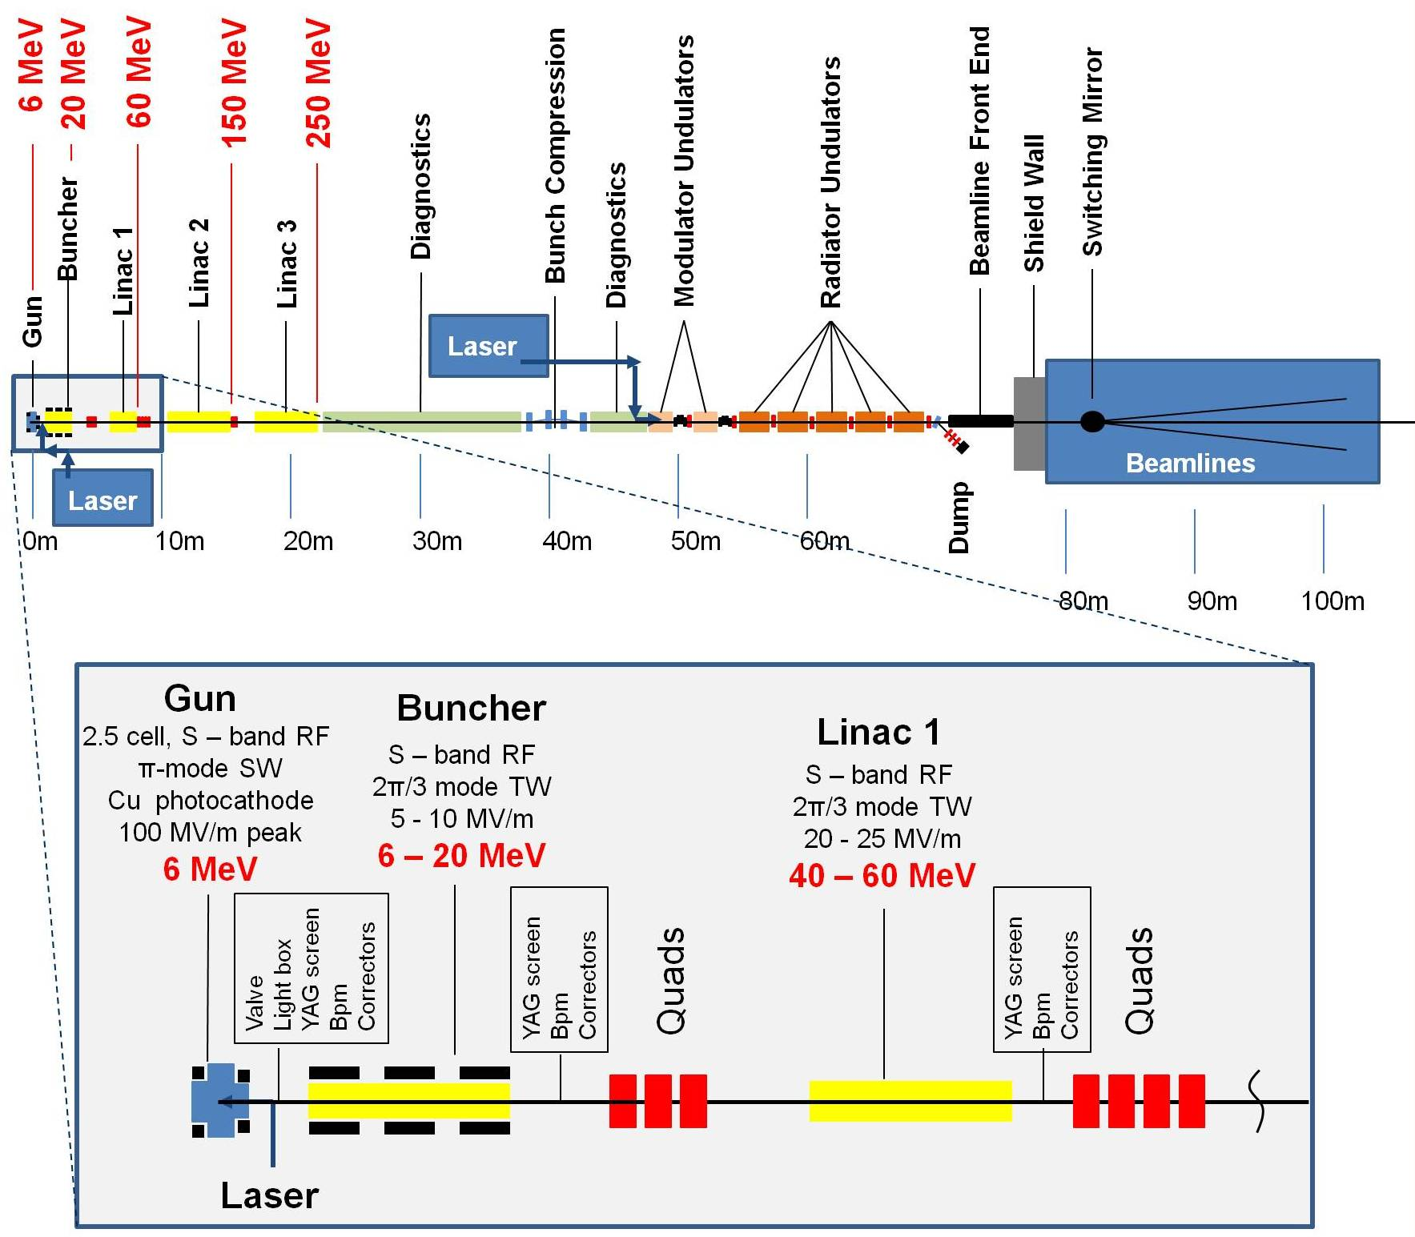
CLARA
New facility
being
designed at
Daresbury
250 MeV
Flexible format
to test variety
of FEL concepts
Open for
collaboration

Slide 31

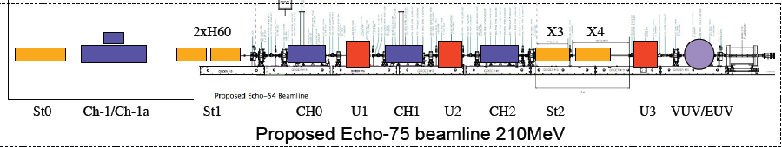
NLC Test Accelerator
Erik Hemsing
4 Chicanes, 3 undulators, 3 lasers, 2 TCAVs, flexible rf,
and lots of diagnostics
Broad program of FEL beam physics & technology possible
Open for collaboration

Slide 32

Final Remarks
THANKS
for a great
workshop!
Thanks to everybody

